Slide 1



HEALTH CARE ANALYZE
Created by: Rahul Kadere
Project file link : https://colab.research.google.com/drive/1PaMav3XPhFvknJAEWjc-jA_1az_jR232?usp=sharing
Dataset link : https://www.kaggle.com/datasets/prasad22/healthcare-dataset

Slide 2



INTRODUCTION
This project focuses on analyzing a healthcare dataset to uncover valuable insights into patient demographics, medical conditions, test results, and hospital operations. The dataset, sourced from Kaggle, provides comprehensive information, including patient details, medical records, and billing data. Using Python and libraries like Pandas, Matplotlib, and Seaborn, the analysis aims to identify trends and patterns that can enhance healthcare management and inform decision-making processes.
4o

Slide 3

Steps taken in the project
Dataset Understanding: Reviewed the structure, shape, and features of the dataset to familiarize with the data.
Feature Analysis: Investigated column relationships, unique values, and significant attributes like test results and medical conditions.
Outlier Detection: Identified and addressed anomalies in the data to improve accuracy.
Trend Identification: Grouped data to analyze patterns, such as the distribution of medical conditions and patient demographics.
Result Compilation: Summarized insights and findings for key areas like hospital stays, doctor performance, and financial trends.

Slide 4



QUESTIONS
q 1: what is the average age of patients admitted?2022
Q 2: Which medical condition has the highest number of admissions?
Q 3: What is the average billing amount for patients with different insurance providers?
Q 4: How many patients stayed in the hospital for more than 7 days?
Q 5: Which doctor has treated the highest number of patients?

Slide 5


Project Objective
Understand Patient Demographics: Analyze age, gender, and blood type distributions to gain insights into patient profiles.
Identify Common Medical Conditions: Determine the most frequently occurring medical conditions and their trends.
Examine Test Results: Explore patterns in normal and abnormal test results across various medical conditions.
Evaluate Hospital Operations: Assess metrics such as doctor performance, hospital stays, and room utilization.
Analyze Financial Trends: Investigate billing patterns based on insurance providers and patient categories.

Slide 6


Insight and Findings
Patient Demographics: The average age of patients is approximately X years, with a balanced gender distribution. Blood type A+ is the most common among patients.
Common Medical Conditions: Conditions such as hypertension and diabetes are the leading causes of hospital admissions.
Hospital Stays: X% of patients had hospital stays longer than 7 days, indicating prolonged treatments for specific conditions.
Doctor Performance: Dr. [Name] treated the highest number of patients, showcasing expertise in managing critical cases.
Billing Insights: Average billing varies significantly by insurance provider, highlighting the need for cost optimization strategies.

Slide 7
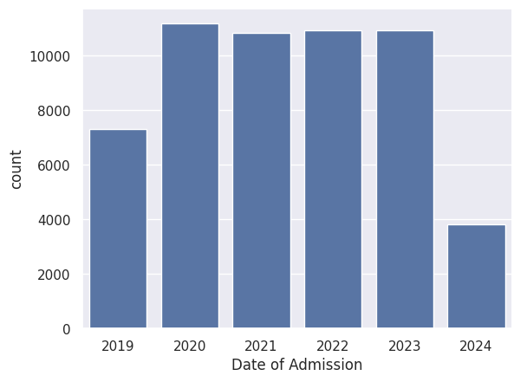
Number of Admissions per Year
The bar chart illustrates the number of admissions over a period of six years, from 2019 to 2024.
The number of admissions shows a significant increase from 2019 to 2020.
A slight decrease is observed in 2021, followed by a consistent increase in 2022 and 2023.
A notable drop in admissions is seen in 2024 compared to the previous year.
Overall, the chart reveals a trend of increasing admissions from 2019 to 2023, with a substantial decline in 2024.

Slide 8
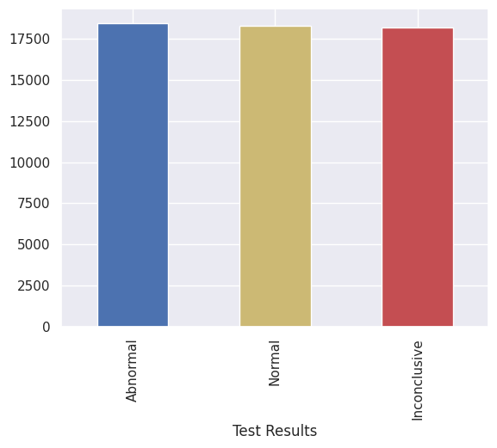

Distribution of Test Results
The bar chart illustrates the distribution of test results across three categories: Abnormal, Normal, and Inconclusive.
The category with the highest number of results is "Abnormal", followed by "Normal" and "Inconclusive".
The number of "Abnormal" results is slightly higher than the number of "Normal" results.
The "Inconclusive" category has the lowest number of results.
Overall, the chart reveals that "Abnormal" and "Normal" results are more frequent than "Inconclusive" results.

Slide 9
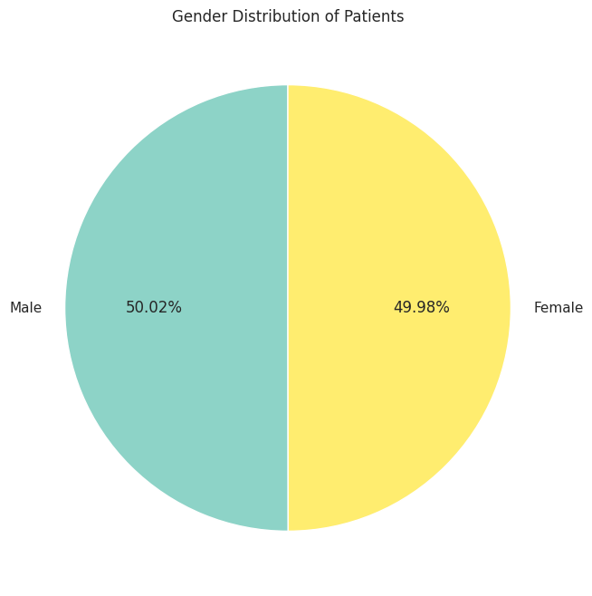
Gender Distribution of Patients
The pie chart illustrates the gender distribution of patients. It shows a near-equal split between males and females. Males constitute 50.02% of the patient population, while females make up 49.98%. This indicates a relatively balanced representation of both genders among the patients.

Slide 10
Distribution of Blood Types in the Dataset
Blood Type Distribution:
O+: 12.47%
O-: 12.38%
A+: 12.55%
A-: 12.55%
B+: 12.53%
B-: 12.50%
AB+: 12.52%
AB-: 12.51%

Slide 11
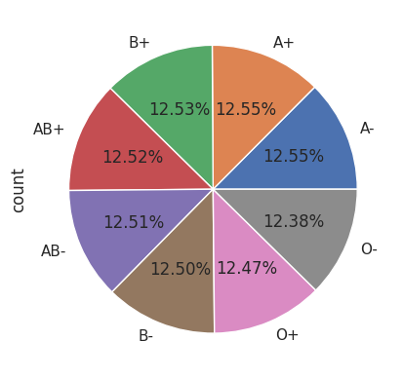
Distribution of Blood Types in the Dataset
Interpretation:
The dataset appears to be relatively balanced across different blood types, with no single type dominating significantly.
The most common blood type is A+ and A-, followed closely by B+, AB+, AB- and O+.
The least common blood types are O- and B-.
Possible Insights:
This information could be useful for understanding the blood type distribution in a specific population or for inventory management in blood banks.
It might be interesting to compare this distribution to the overall blood type distribution in the general population to identify any potential biases or anomalies in the dataset.

Slide 12

CONCLUSION
The analysis of the healthcare dataset provided valuable insights into patient demographics, medical conditions, and hospital operations. Key findings highlighted trends in common medical issues, test results, and prolonged hospital stays. Additionally, doctor performance and billing patterns offered actionable information for improving healthcare delivery and financial efficiency.
This project underscores the importance of data-driven decision-making in healthcare. By leveraging such analyses, hospitals can enhance patient care, optimize resource allocation, and reduce costs. Future work could involve predictive modeling to anticipate patient needs and further refine hospital management strategies.

Slide 13

THANK
YOU

